Slide 1





Ernst Peter Tamminga
Get started with GitHub
XCESS expertise center b.v.
Netherlands

Slide 2

Get started with GitHub

Slide 3

Pull request

Slide 4

Objectives
Put your module on GitHub
  And share!
Get YOUR copy of an existing module
  Improve it
  Give your improvement back
Learn some Git terminology

Slide 5
Prerequisites
Account on www.github.com
Software
  SourceTree (Open Source GitHub enhancement)
  Visual Studio (or any code editor)
Some source code (module, skin)
  That you want to share

Slide 6

Why?
DNN = Open Source = Community = Contributing = Sharing

Slide 7
Put your module on GitHub
Use Git(Hub) as source control and source sharing

Slide 8
Who is already working with GIT(Hub)?
And what do you do with that?

Slide 9
GitHub
GitHub
Repository
“Orgin”
1
4
Clone
Your disk
Push
2
Local
Repository
Edit
Stage
Commit
3

Slide 10
Put your module on GitHub
Create a repository on GitHub
Clone this repo to a folder on your local drive
Add all files from your module to that folder
  Stage the (new) files to your local repo
  Commit the changes to your local repo
Push the commit to the GitHub repo

Slide 11
Put your module on GitHub
DEMO

Slide 12
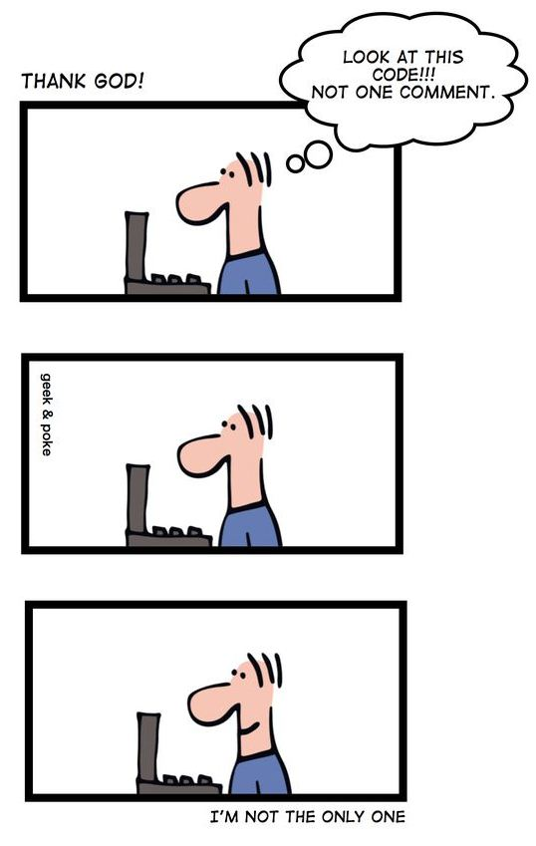

Slide 13
Get your Copy of an Existing module on GitHub
Use Git(Hub) as source control and source sharing

Slide 14
GitHub
GitHub
original
repository
GitHub
Repository
“Orgin”
Fork
1
Clone
Your disk
Push
Local
Repository
2
Edit
Stage
Commit

Slide 15
Get your copy of a module
Fork the repository on GitHub
Do the usual things
  Clone this repo to a folder on your local drive
  Create a branch on your local repo
  Make your changes: Edit, Stage, Commit
  Push the commit to your GitHub repo

Slide 16
Get your copy of a module
DEMO

Slide 17
Give improvements back to the original module owner
Share your results

Slide 18
Give improvements back
Fork the repository on GitHub
Do the usual things
  Clone this repo to a folder on your local drive
  Create a branch on your local repo
  Make your changes: Edit, Stage, Commit
  Push the commit to your GitHub repo
Add the original repo as UpStream repo (once) and fetch the latest changes
Create a Pull request for the UpStream repo

Slide 19
GitHub
GitHub
repository
“UpStream”
4
Pull Request
GitHub
Repository
“Orgin”
Your disk
3
Local
Repository
UpStream

Slide 20
Give improvements back
DEMO

Slide 21


Slide 22
Submit changes for DNNPlatform
Select or Create a JIRA issue
Commit your changes (locally)
Push the change to your origin
Create Pull Request for the UpStream (DNNPlatform)

Slide 23
Git(Hub) terminology
Repository (aka Repo)
Fork
Clone
Stage
Commit
Push
Pull request
Origin
UpStream

Slide 24

Goal reached?

Slide 25
I need some Assistance
DNN.Events
DNN.FAQ
DNN.Reports
DNNSoftware.com
DNN = Open Source = Community = Contributing = Sharing

